Slide 1
My Robotic Friends
Introductory Activity

Slide 2
Vocabulary
Algorithm - A series of instructions on how to accomplish a task
Coding - Transforming actions into a symbolic language
Debugging - Finding and fixing issues in code

Slide 3
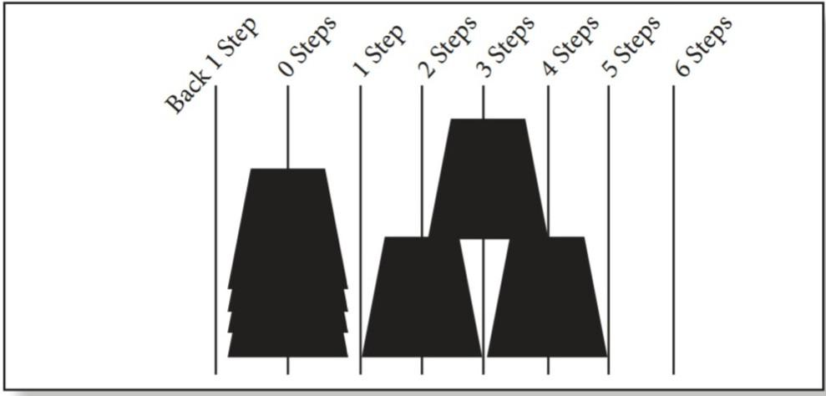
Guide

Slide 4
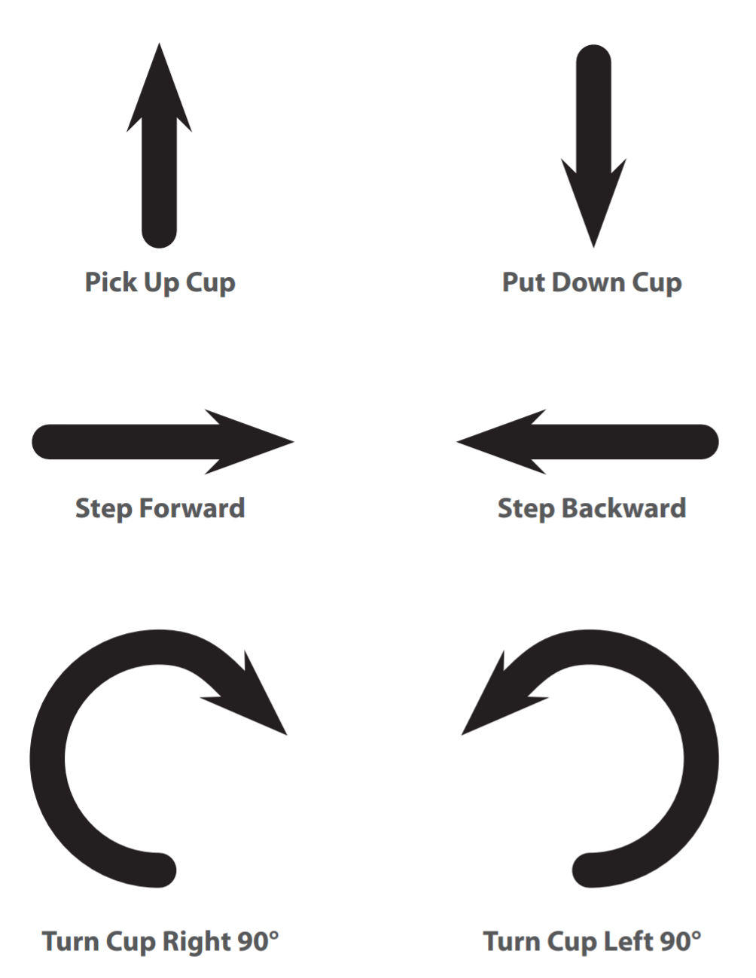
Symbols

Slide 5
ROBOT, ROBOT, WHERE ARE YOU?
CAMBOT 8000, we need your assistance!!!

Slide 6

First Example
CLASS CHALLENGE: Write the code CAMBOT needs to build this stack

Slide 7
Solution

Slide 8
Think Like a Coder
What is wrong with our solution?

Slide 9

What if this were the next stack?

Slide 10
More Vocabulary
Function - A piece of code that can be called over and over
Parameters - Extra bits of information that you can pass into a function to customize it

Slide 11
Function Symbol
X
X
X
X is the number of times the robot should move forward, backward, or rotate. For example, Move forward 3 times. X is the parameter to our function
CHALLENGE: Use our new functions to rewrite, your solutions.
3

Slide 12
Solution 1 (Refactor)

Slide 13
A better solution!
2
2
4
4
3
2
3
3

Slide 14
Steps
Choose one “Robot” per team.
Send robot to “Robot Library” while the programmers code.
Choose one image from the Cup Stack Pack for each group.
Groups will create an algorithm for how the robots should build the selected stack.
Coders will translate their algorithm to arrows, as described in Symbol Key.
When programmers have finished coding their stack they can retrieve their robot.
Upon return, the robot reads the symbols from the cards and translates them back into movements
The group should watch for incorrect movements, then work together to debug their program before asking the robot to re-run it.

Slide 15
Rules
Coders should translate all moves using the symbols suggested.
Cups should remain with the robot.
Once robots are back with their groups, there should be no talking out loud.

Slide 16
Coding Time!!!
Go!

